Slide 1
Ultrasonic Ranging Module
Group 4 – Quan Gu

Slide 2

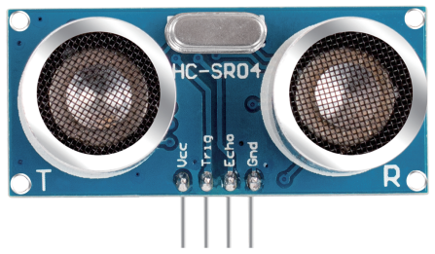
Introduction
Ultrasonic Module Ultrasonic ranging module provides 2cm - 400cm non-contact measurement function, it includes ultrasonic transmitters, receiver and control circuit.

Slide 3
Introduction
Some Knowledge about the Ultrasonic sensors and actuators
These ultrasonic sensors are very common in applications in air (typical frequencies are 24 and 40 kHz) for range finding and obstacle avoidance in robots.
The main difficulty with the propagation of ultrasound in air is that the attenuation of by high-frequency ultrasound in air is high so that the range of these devices is relatively short.

Slide 4
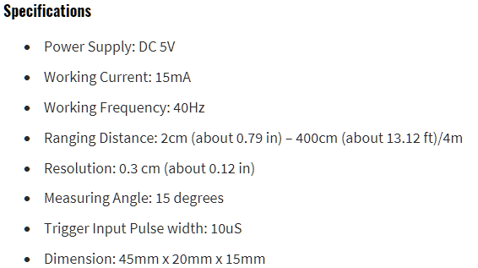
Specifications of the module
Based on this chart and the actual measurement of the module, we are going to find some important static characteristics of Ultrasonic Module.
1. Ranging Distance
2. Measuring Angle
3. Accuracy
4. Precision

Slide 5
Ranging Distance
In this part, we will measure the maximum and minimum distances accurately detectable by the Ultrasonic Module.
Procedure: Place objects at various distances within the specified range (2cm to 400cm). Slowly move the module to within 2cm and beyond 400cm, compare the measured distance with the actual distance using precise measuring tools, and repeat the process multiple times to ensure consistency and accuracy.

Slide 6
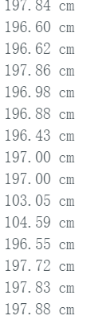
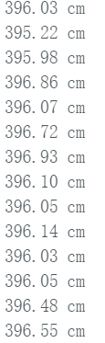
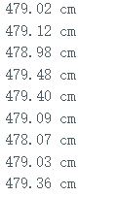
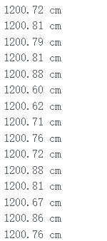
Ranging Distance
200cm
400cm
500cm
Maximum distances
Place objects 200cm, 400cm, 500cm, 700cm, 800cm, and 1000cm in front of the sensor. When the distance is less than 500cm, the sensor can stably read data. If the distance exceeds 500cm but is below 800cm, the data begins to fluctuate severely and cannot obtain stable data. If the distance exceeds 800cm, precise measurement cannot be achieved.
It can be inferred that the optimal maximum measurement distance of the sensor is approximately 500cm.
>800cm
800cm

Slide 7
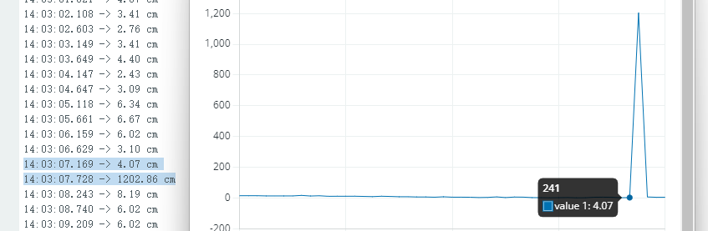
Ranging Distance
Minimum distances
Gradually approaching the sensor, it can be noticed that the data suddenly stops at 4cm
h/cm
t/s

Slide 8
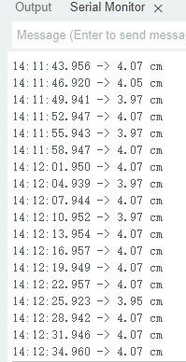
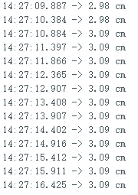
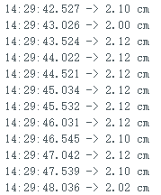
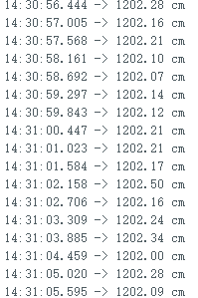
Ranging Distance
Minimum distances
Slow down the approach speed and approach the sensor from 4cm. It can be noticed that the sensor cannot detect data when it is less than 2cm. So we can infer that the minimum detection distance is 2cm.
4cm
3cm
2cm
<2cm

Slide 9
Measuring Angle
In this part, we will determine the feasibility of the module at different measurement angles.
Place an object in front of the sensor, first put the sensor horizontally and vertically on the table. Then tilt it upward at a certain angle until no more value can be measured.

Slide 10
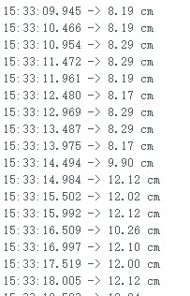
Measuring Angle
Place the object 8cm in front of the sensor, first place the sensor horizontally, and note that the sensor can read data up to 8cm.
Gradually increase the angle of the sensor, and the data is also gradually increasing. When the error between the data and the actual value is too large, record the current angle.
It can be inferred from this that the measurement angle is approximately 15-20 degrees.

Slide 11
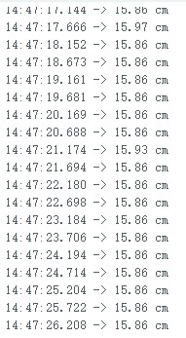
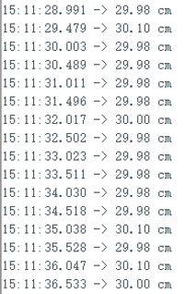
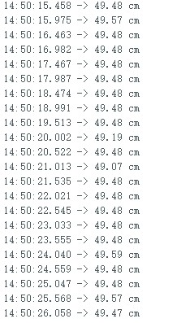
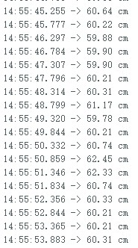
Accuracy
In this part，we will evaluate the data accuracy of the ultrasonic module
Place the objects 15cm, 30cm, 50cm, and 60cm in front of the sensor, and compare the data with the actual distance. We can observe that the error of the sensor is basically within plus or minus 0.5cm
15cm
30cm
50cm
60cm

Slide 12
Precision
In this part, we will assess the repeatability and consistency of distance measurements.
Procedure: Repeat distance measurements multiple times for a fixed object at a specific distance. Calculate the standard deviation or variance of the measurement distance to quantify accuracy. Evaluate the module's ability to consistently measure the same distance under the same conditions.

Slide 13
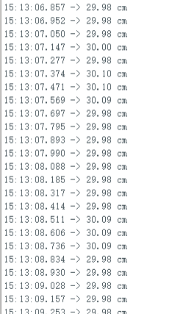
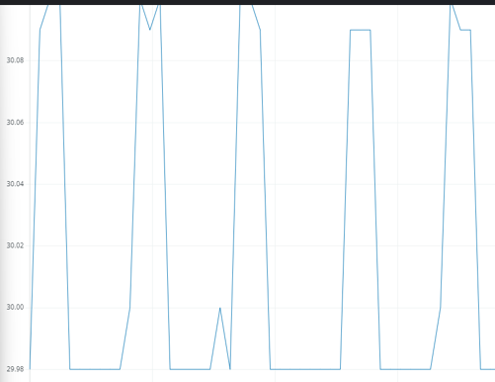
Precision
In this part, we will assess the repeatability and consistency of distance measurements.
Place the object 30cm in front of the sensor, measure multiple sets of data at rest, and calculate the standard deviation and variance of the measurement distance.
The Mean: 29.8932 cm
The Variance: 0.005761 cm^2
The Standard Deviation:s≈0.0759 cm

Slide 14
Conclusion
Through this measurement, we can comprehensively understand the performance characteristics of the ultrasonic module, while also paying attention to some of its shortcomings, such as data fluctuations during measurement and the potential adverse effects of the environment on the sensor.

Slide 15
Thank You ！

